Slide 1
Automobile Cooling Systems

Slide 2
Types
Air Cooled:
Older
Runs cool air through the engine block
Liquid Cooled:
Newer and more efficient
Coolant + tubes around engine

Slide 3
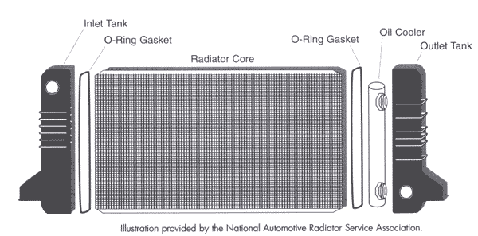
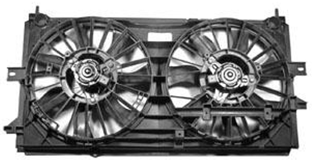
How It Works
Coolant absorbs heat when engine hot
Heat lost in radiator
Heater core heats up coolant when engine cold
Hot coolant distributes heat
The coolant runs through tubes, and the air rushing past cools the coolant down.
The radiator fans direct air flow through the radiator.

Slide 4
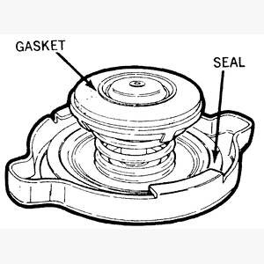
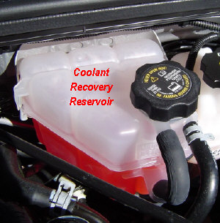
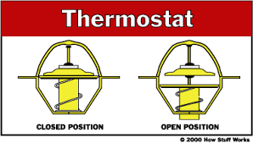
The radiator pressure cap and reserve coolant tank work together to keep the pressure of the coolant at a constant so as to avoid overheating.
The thermostat is what determines if the coolant returns to the radiator or the engine.

